Slide 1
Roundtable Discussion
Jimmy Hwang

Slide 2
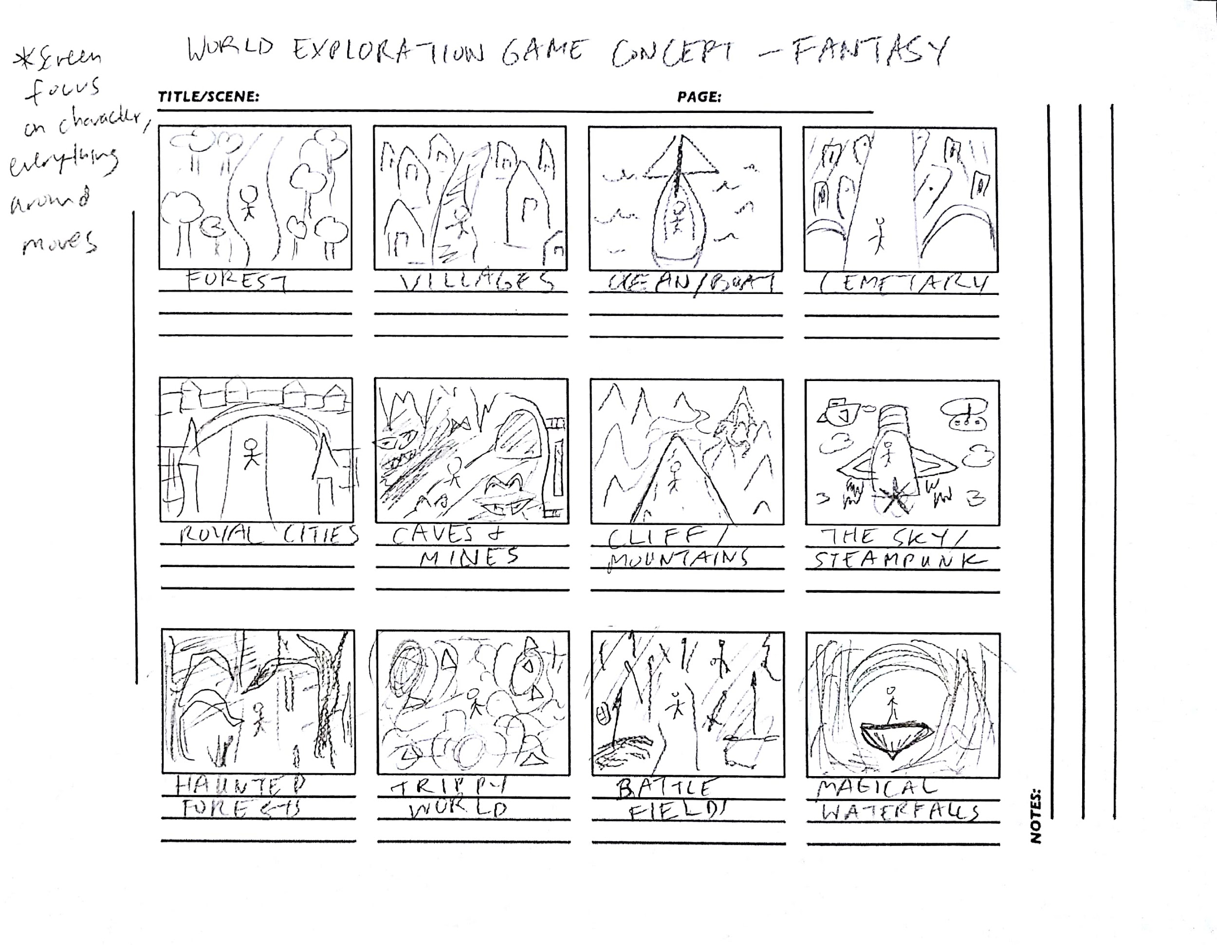

Slide 3



Slide 4
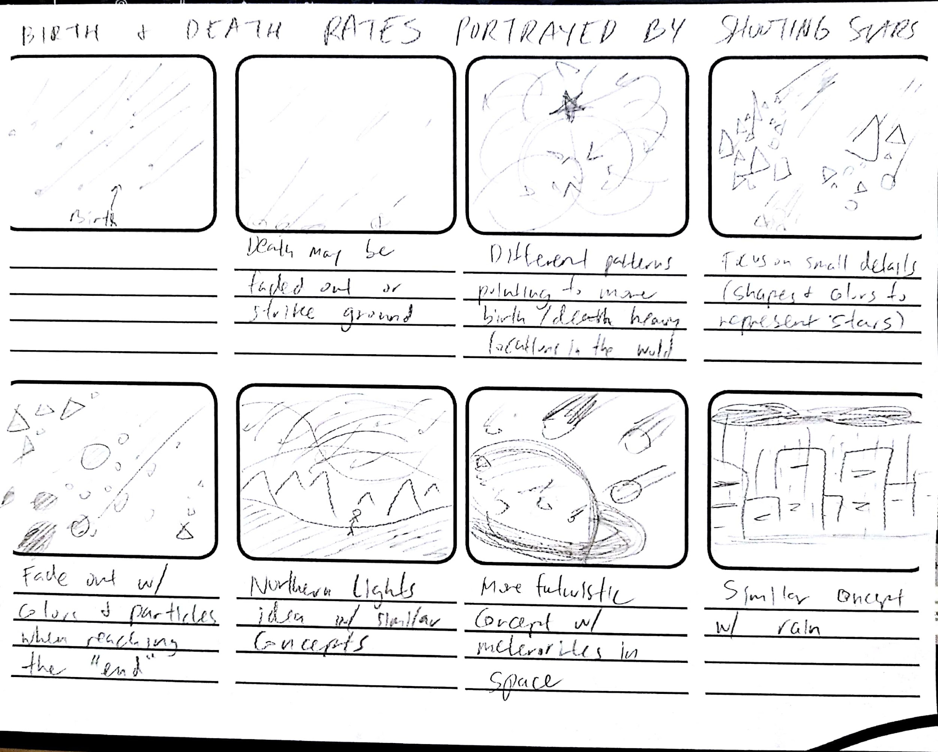

Slide 5
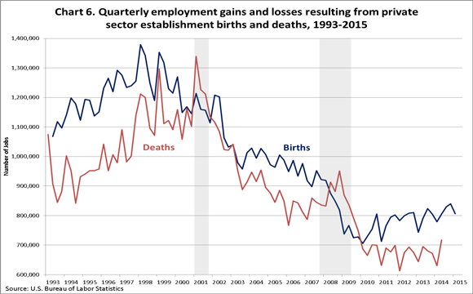
https://www.youtube.com/watch?v=LlexW25Rfv8

Slide 6
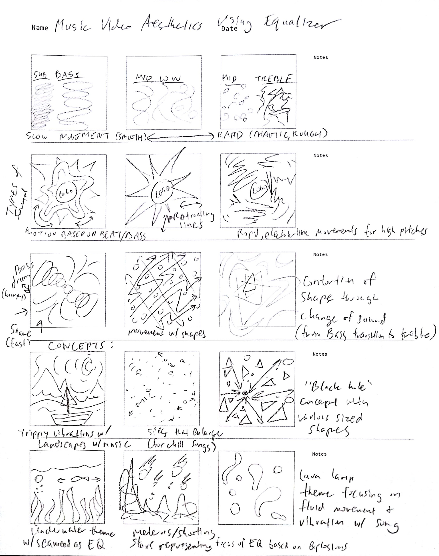

Slide 7


https://www.youtube.com/watch?v=TTi8hQcVvZc

Slide 8
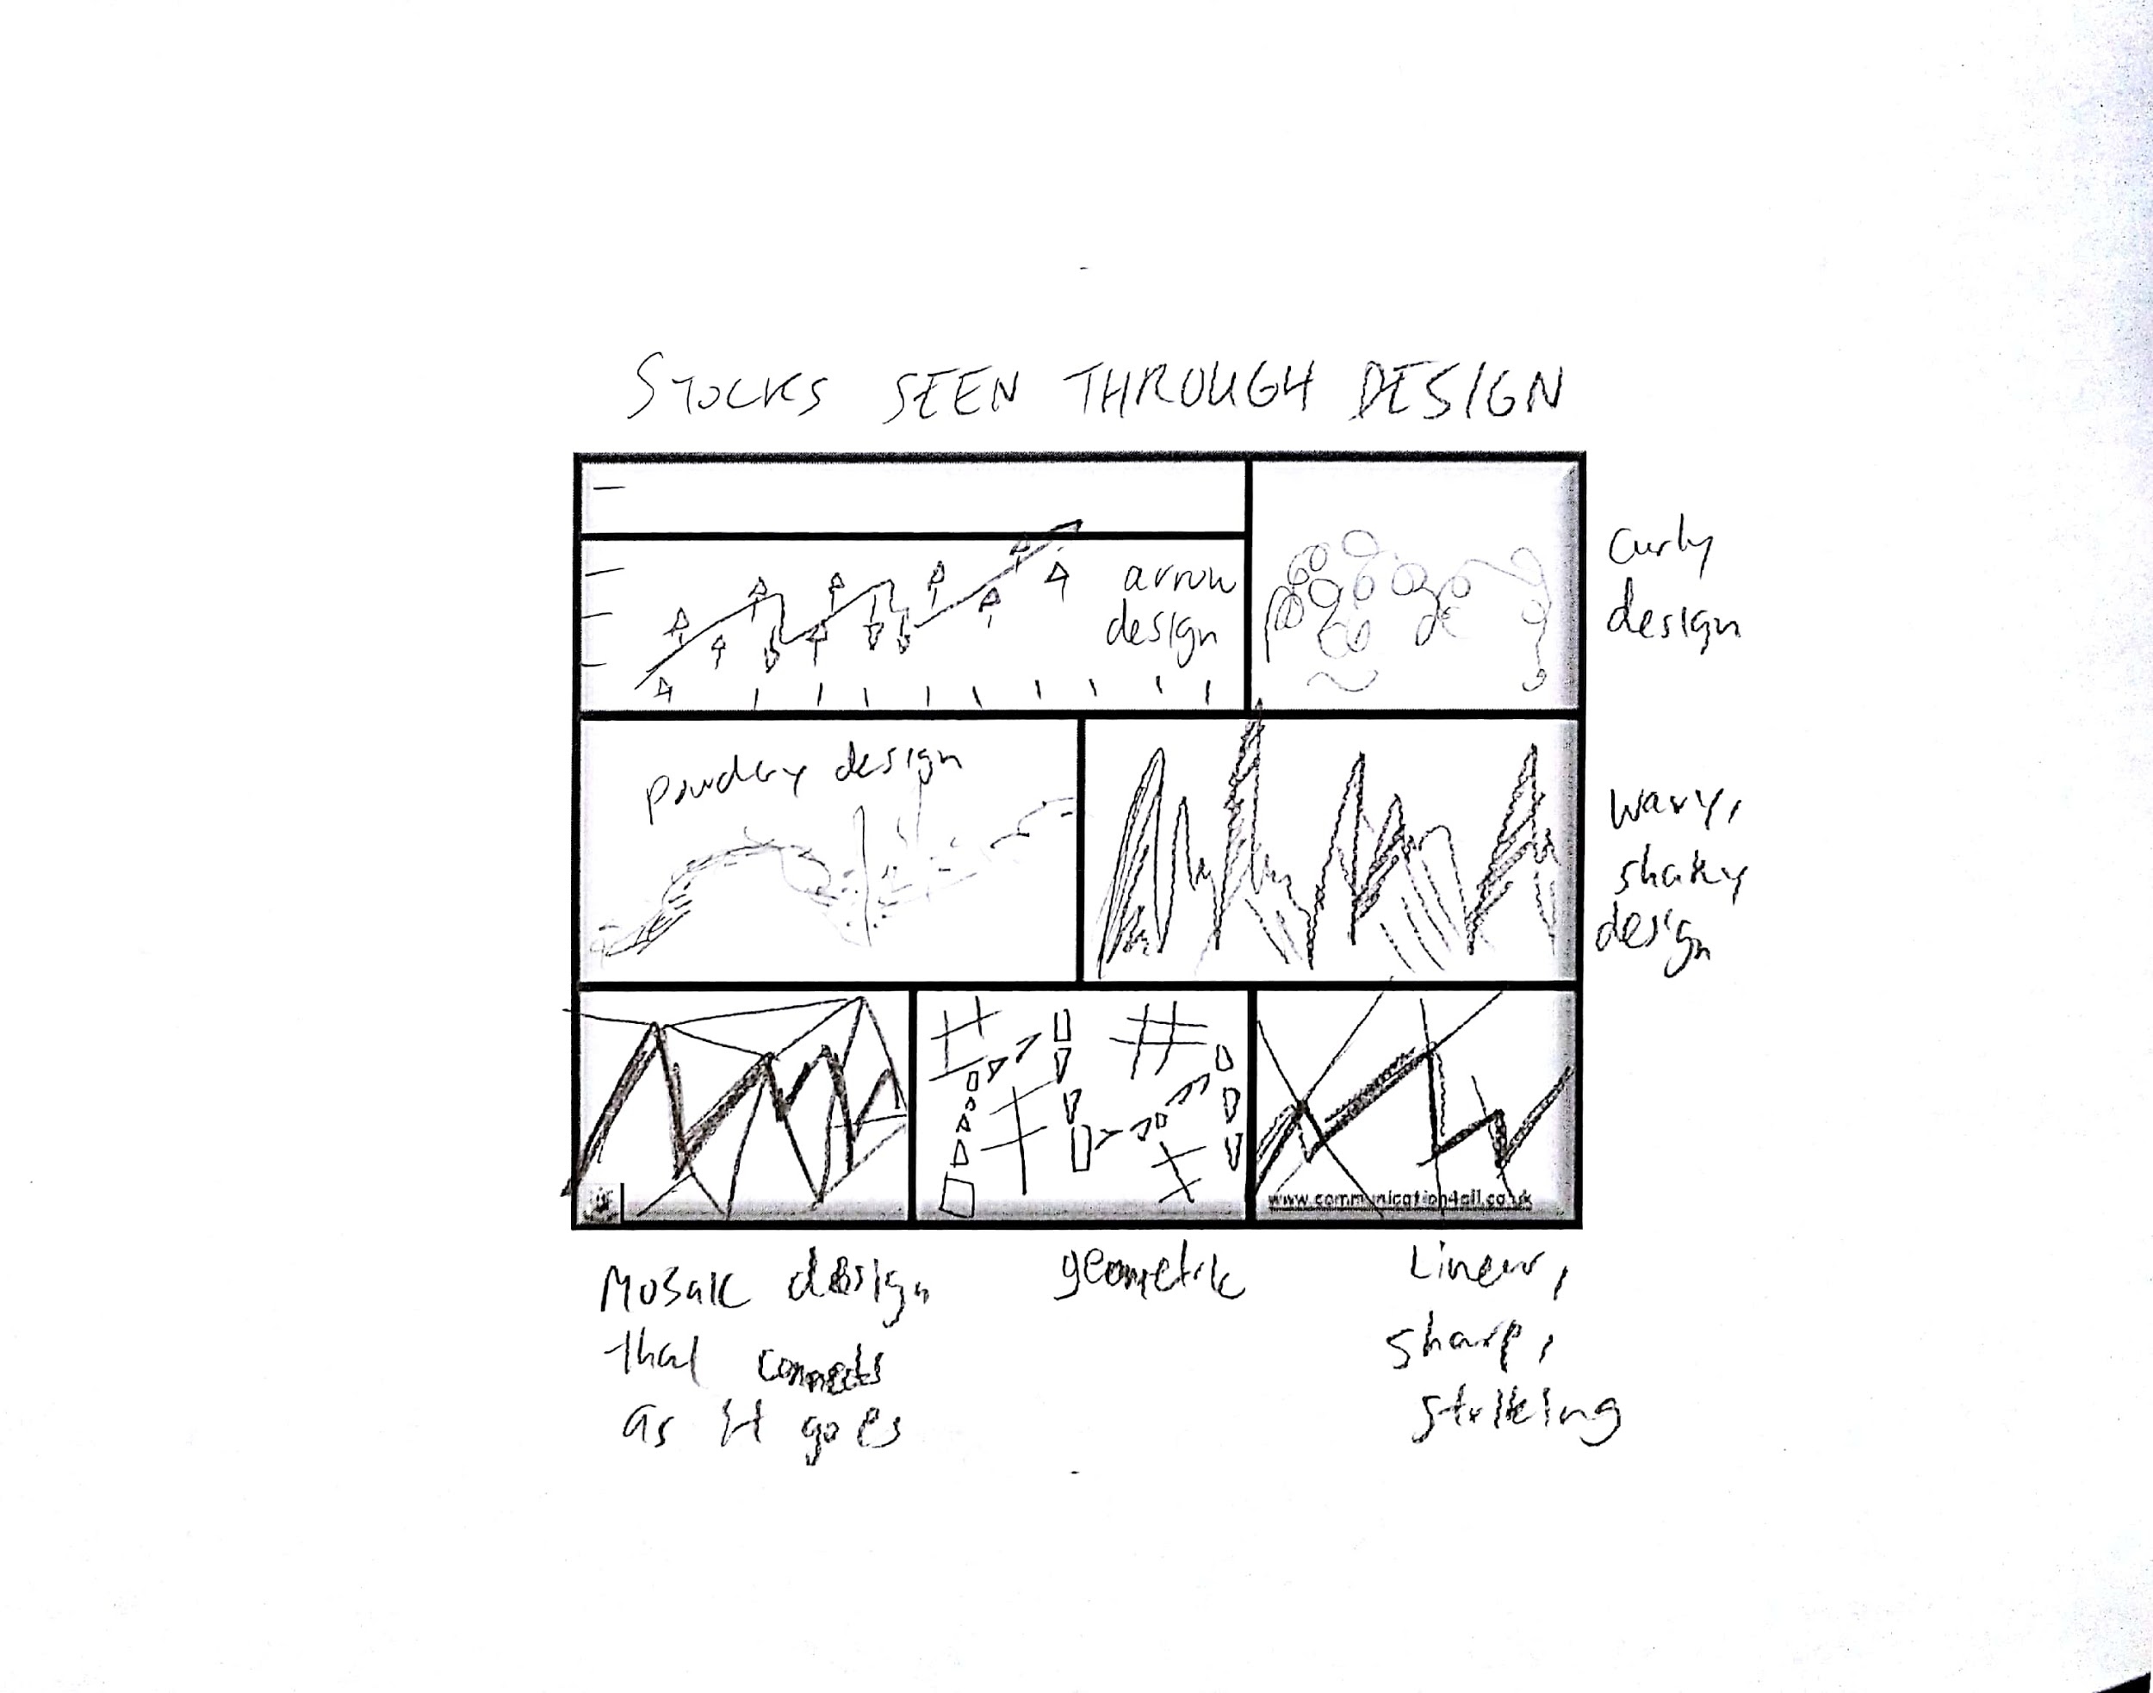

Slide 9

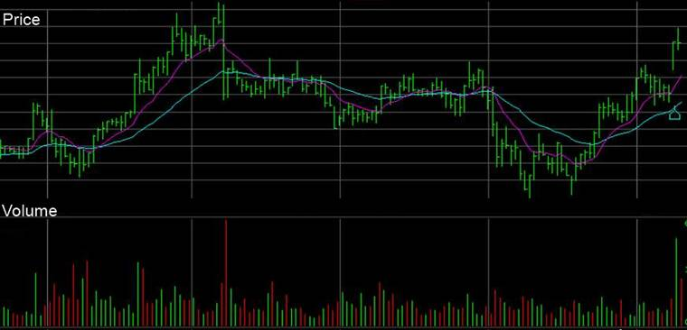
https://www.gettyimages.com/detail/video/animated-stock-numbers-graphs-and-charts-stock-footage/472712325

